Slide 1

Planning for Failure
Jesse Phelps
@jessephelps

Slide 2
Planning for Failure..?

Slide 3
Failure? I don’t write code that fails. I’m a professional!
- YOU

Slide 5
Here's the Reality
We try hard
We study past failures
We test, hopefully automated
We QA
And we still FAIL

Slide 7
How to Plan for Failure
What might fail?
What does failure look like?
How severe of a problem is it?
How likely is it to fail?
Can we detect it when it happens?
How do we respond when it does?

Slide 8
Define failure
Failure is the state or condition of not meeting a desirable or intended objective, and may be viewed as the opposite of success.

Slide 9
Define failure
Failure is the state or condition of not meeting a desirable or intended objective, and may be viewed as the opposite of success.

Slide 10
Methods & Tools
Failure Mode and Effects Analysis
Data Exploration
Pre-Mortems
Chaos Monkey
Fuzz & Mutation Testing

Slide 11
FMEA

Slide 12
Failure Modes and Effects Analysis
Failure Modes – “the ways, or modes, in which something might fail”
Failures are any errors or defects, especially ones that affect the customer, and can be potential or actual.
Effects Analysis – “studying the consequences of those failures”

Slide 13
Risk Prioritization Number (RPN)
Severity * Probability * Detection
Severity of the event
Probability it will occur
Probability that the event will not be detected before the user becomes aware

Slide 14
ATM

Slide 15
Demos

Slide 16
Use it on anything!
Relationships with a client
Deployment systems
Company communication patterns

Slide 17
Data Exploration

Slide 18
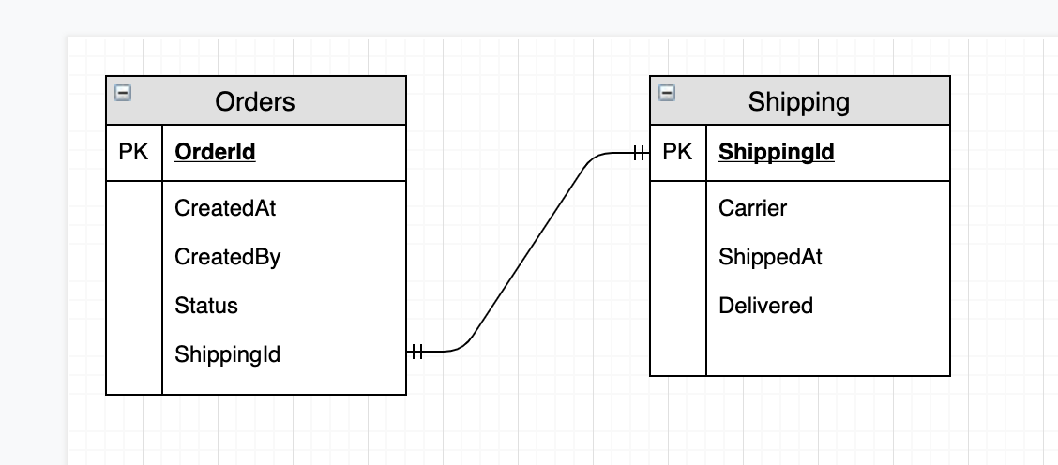
Paradoxes
What data combinations should be impossible?

Slide 19
Paradoxes
SELECT * FROM ORDERS JOIN SHIPPING
On….
WHERE Status = ‘Cancelled’ AND Delivered = 1

Slide 20
Anomaly Detection
Setup pattern based detection
Historically on Mondays, I know we have over 100 orders from this customer by noon. I want a query to alert me if noon comes around and we have fewer than 100 orders from them.
This server normally sees user activity increases at noon.

Slide 21
In practice
SELECT ‘Orders Cancelled And Delivered’, *
FROM Orders JOIN Shipping
ON…
WHERE Status = ‘Cancelled’ AND Delivered = 1;
SELECT ‘Bob didn’t order 100’, *
FROM Orders
WHERE CustId = ‘Bob’ AND CreatedAt > Convert(date, getdate())
GROUP BY CustId
HAVING COUNT(*) < 100;

Slide 22
Pre-mortum

Slide 23
Pre-mortum
Pretend something happened
If X happened, where would you start looking?
All hands on deck
Involve all the players
Product owner included!
Stage a fire-drill
Probably needs a good, mostly full, QA environment.

Slide 24
Security Fail
What happens if you find a breach?
What happens to the data they got? Can they use it?
What would you do if someone asked for a ransom or maybe a bug bounty?

Slide 25
Tools

Slide 27
Chaos Monkey
Netflix Simian Army
Chaos Monkey
Janitor Monkey
Conformity Monkey
Principles of Chaos Engineering http://principlesofchaos.org/
.01% * 100,000 = 10

Slide 28
Fuzz Testing
Random input
But crazy random… lkjsdfo8u92849sdf

Slide 29
Fuzz unit tests

Slide 30
Fuzz unit tests

Slide 31
Mutation Testing
Real Code
if (a && b) { c = 1; } else { c = 0; }
Mutant
if (a || b) { c = 1; } else { c = 0; }

Slide 32
Key Takeaways
You can’t avoid failure...
Try to! But accept reality.
It’s all about ROI and diminishing returns.

Slide 33
Be prepared for failure so that you can be successful. Thanks for coming!
Jesse Phelps
@jessephelps
http://www.jessephelps.com

